Slide 1
PHPUnit

Slide 2
Agenda
Unit Testing
What is PHPUnit
PHPUnit Conventions
Features of PHPUnit
Code-Coverage Analysis
What are Mock Objects
Adding a Config File

Slide 3
Unit Testing
A unit is the smallest testable part of an application.
A unit test, is a sanity check to make sure that the chunk of functionality does what it’s supposed to.
Whenever you make a change to your code, you have to run the set of tests. That way, you can be reassured that you haven’t inadvertently broken another part of your application.

Slide 4
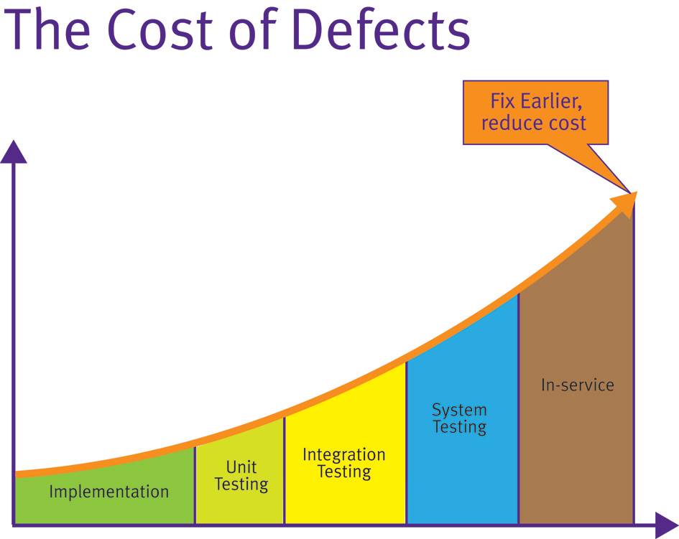
Unit Testing
Unit testing your application will not only save you a lot of headaches during development, but it can result in code that’s easier to maintain, allowing you to make more fearless changes (like major refactoring) without hesitation.
The later a defect is identified, the higher the cost of rectifying it.

Slide 5
PHPUnit
PHPUnit is a unit testing framework written in PHP, created by Sebastian Bergman.
Part of the xUnit family of testing frameworks
While there are other unit testing frameworks for PHP (such as SimpleTest or Atoum) PHPUnit has become the de facto standard.
Major frameworks, such as Zend, Symfony and Cake, and many other PHP projects such as Doctrine have test suites written with PHPUnit.

Slide 6
PHPUnit Conventions
The tests for a class ABC go into a class ABCTest.
Test class should extend the class PHPUnit_Framework_TestCase.
Each test should be a public methods with name prefixed with “test”.
Test file must mirror the codebase directly but within its own folder.
Compose a test suite to keep all test case source files in a test directory.

Slide 7
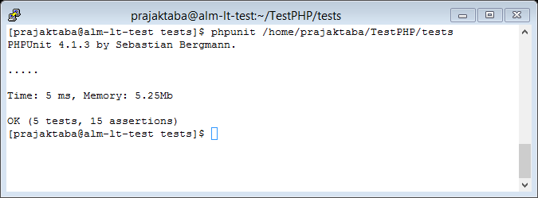
Features of PHPUnit
COMMAND LINE TEST RUNNER
The PHPUnit command-line test runner can be invoked through the phpunit command.

Slide 8
The Command-Line Test Runner
For each test run, the PHPUnit command-line tool prints one character to indicate progress:
Character | Description
. | Printed when the test succeeds.
F | Printed when an assertion fails while running the test method.
E | Printed when an error occurs while running the test method.
S | Printed when the test has been skipped
I | Printed when the test is marked as being incomplete or not yet implemented

Slide 9
Assertions
Assertions are used to test expected behavior from your source code.
PHPUnit provides many different assertions for all sorts of needs, e.g.
assertEquals, assertEmpty, assertTrue, assertFalse(), etc.
PHPUnit ships with 90 assertions.
PHPUnit also provide provision for creating custom assertions.
For a test to pass all assertions must evaluate to true.

Slide 10
Annotations
PHPUnit supports annotations to give instructions to the test method being executed.
Annotations are included in block comments before the method and always begin with an ‘@’
Examples: @depends, @expectedException, @dataProvider.

Slide 11
Data Providers
A data provider is a method that returns an array of values to use in a test.
PHPUnit will call the related test method once for each set of data, passing the values as arguments to the method.
Set using the @dataProvider annotation.
Makes tests shorter and more concise by keeping values to test with out of test methods.

Slide 12
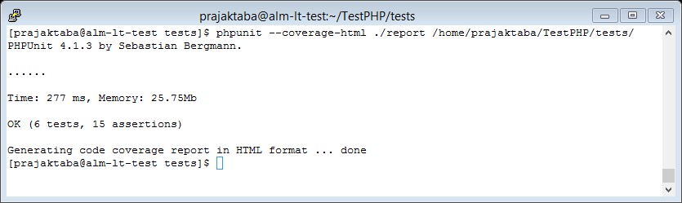
Code-Coverage Analysis
Code coverage tells you how much of your code is covered by tests.
PHPUnit can generate code coverage reports in a number of formats including HTML, clover, crap4j, text, xml etc.
You must have installed xDebug.

Slide 13
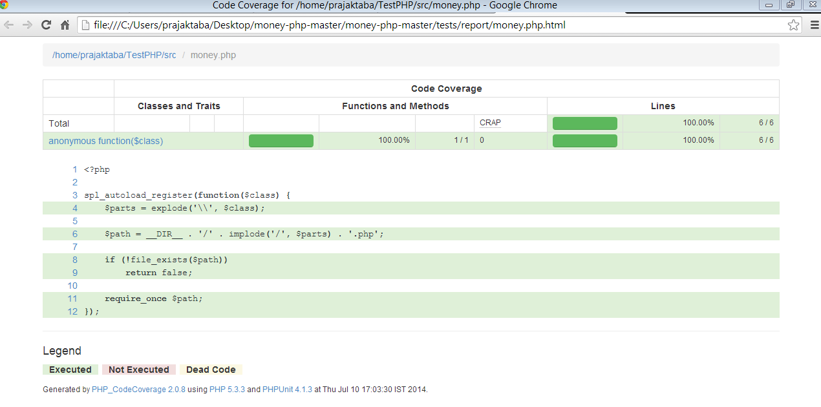
Code-Coverage Analysis

Slide 14
What are MOCK Objects
One of the most powerful features of PHPUnit.
Allows us to replace dependency.
It basically involves replacing the actual object with a fake, or ‘mock’, object that we fully control, removing all dependencies on outside systems or code that we really have no need to test.
You need to be using Dependency Injection to use mock objects.
PHPUnit creates a mock by sub-classing the original object.
Once you have a mock object you can define what methods you expect to be called on it, with what arguments and what the mock should do.

Slide 15
Adding a Config File
Options can be passed to PHPUnit through the command line but it also supports adding an XML config file.
This can include a number of options such as where to find test cases and which directories to include for code coverage analysis.
To use this just create the file and name it phpunit.xml, adding it to the root of your tests directory
Especially useful when running tests as part of a CI build.

Slide 16

Any Questions?

Slide 17
Thank You!

